Slide 1

SQL in a SERVER Environment
Group of
Nguyen Tuan Anh
Nguyen Tran Phong
Vo Van Thanh Phuc

Slide 2

Content
The Three-Tier Architecture
The SQL Environment
The SQL / Host-Language Interface
Stored Procedure
Using a Call-Level Interface
JDBC
PHP
1
2
3
4
5
6
7

Slide 3

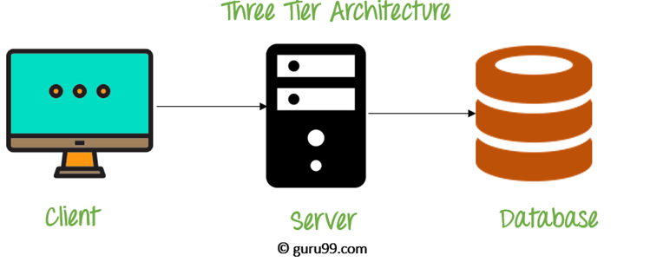
1. The Three-Tier Architecture
The Application
Server
The Web
Server
The Database
Server

Slide 4
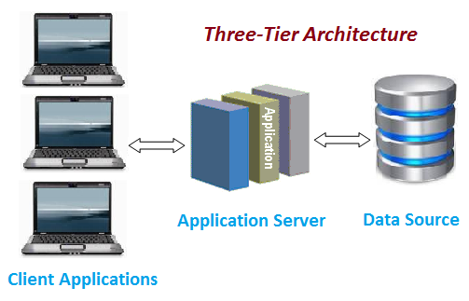
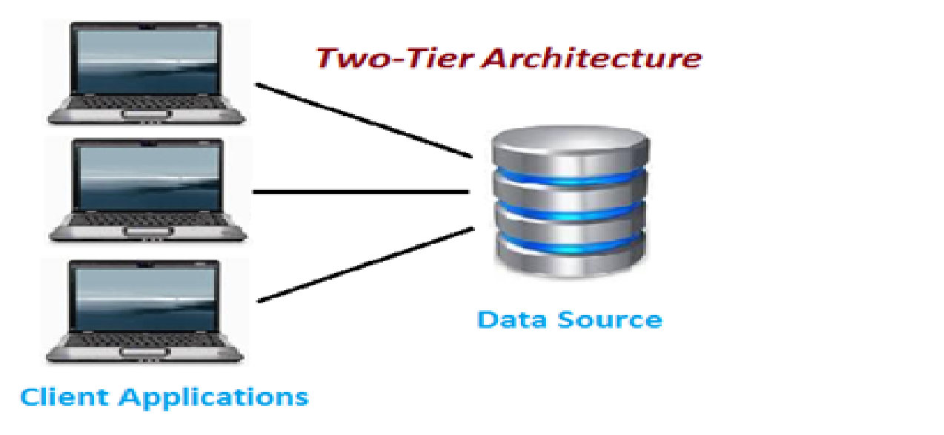
1. The Three-Tier Architecture
Why Three-Tier Architecture?
More secured.
More efficient.
“A three-tier architecture requires more planning and support [...], but it offers advantages in openness, flexibility, scalability, and integration.”
(Gallaugher & Ramanathan, 1996)

Slide 5
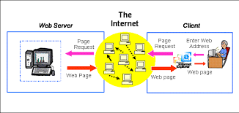
1. The Three-Tier Architecture
1.1 The Web Servers Tier
Processes that manage user's interactions.
Typically running Apache/Tomcat.
The user is also known as “client”.

Slide 6
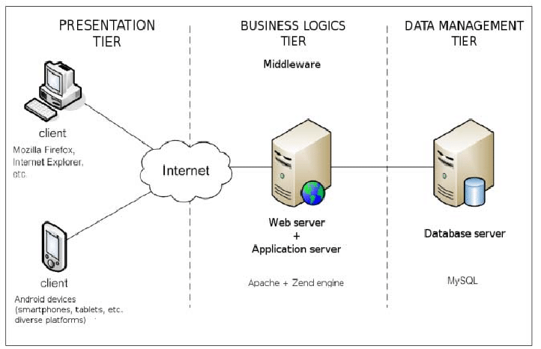
1. The Three-Tier Architecture
1.2 The Application Tier
Response to the web server's request with the database's data.
Might evoke application-tier processes to handle the request.
Actions performed are known as “business logic”.

Slide 7
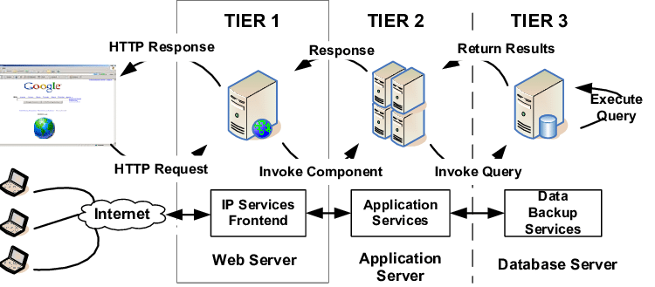
1. The Three-Tier Architecture
1.3 The Database Tier
Execute queries submitted by the Application Tier.
Support large number of connections to optimise processing time.

Slide 8

2. The SQL Environment
2.1 Environments
2.2 Schemas
2.3 Catalogs
2.4 Clients and Servers
2.5 Connections
2.6 Sessions

Slide 9
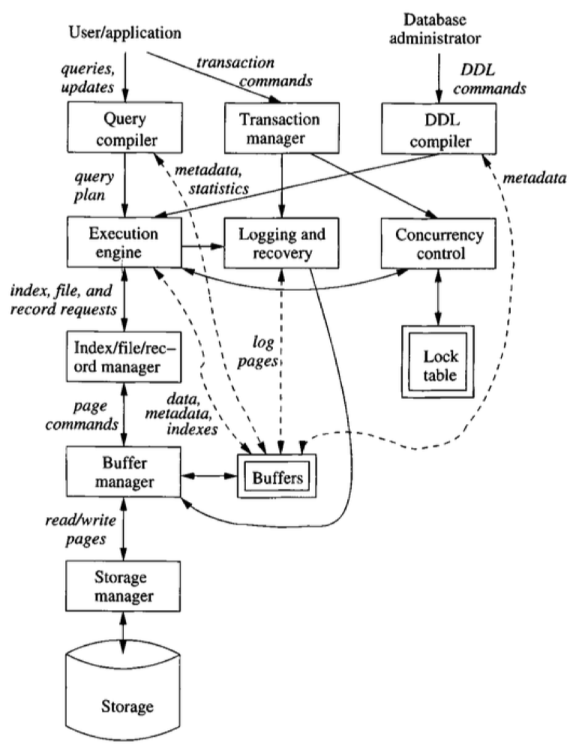
2. The SQL Environment
2.1 SQL Environments
The framework that SQL operates on.
A DBMS running at some installation.
“A database management system (DBMS) is (a) computer software that stores data and provides software routines for manipulating the stored data”
(Goldbert, R. N., & Jirak, G. A)

Slide 10
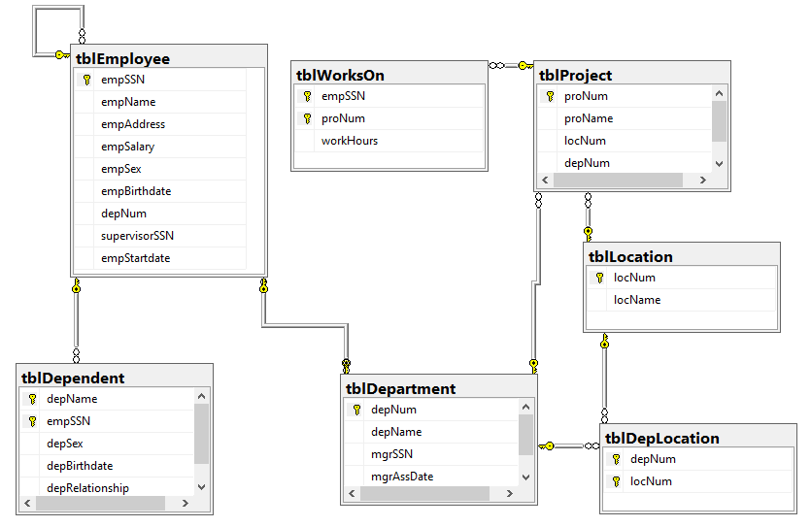
2. The SQL Environment
2.2 Schemas
Collection of tables, views, triggers and other types of information.
The basic unit of an organisation contributing to the database.

Slide 11
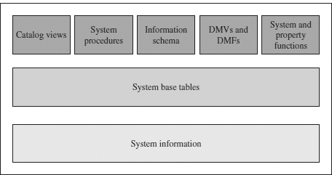
2. The SQL Environment
2.3 Catalogs
The over-arching warden of Schemas.
Schemas are managed in Catalogs akin to how Tables are managed in Schemas.

Slide 12
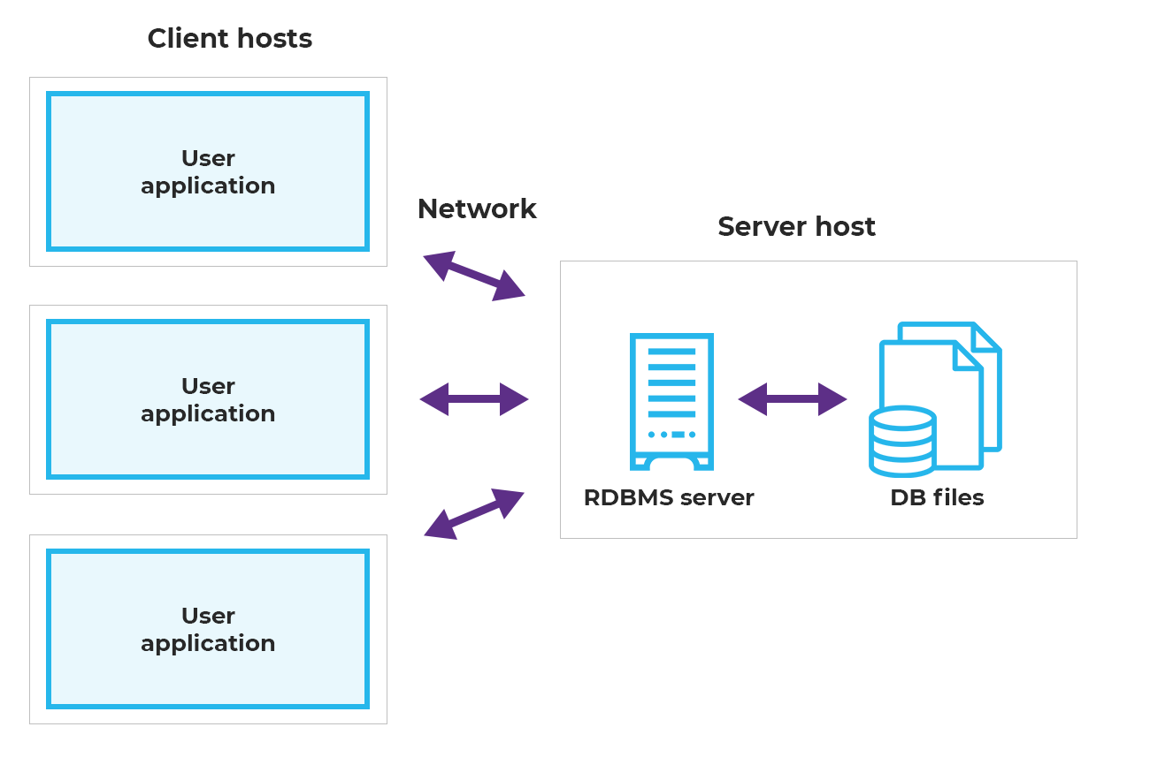
2. The SQL Environment
2.4 Clients and Servers
Two types of processes:
SQL Server poses as the “database”.
SQL Client are held as the “application servers”.

Slide 13
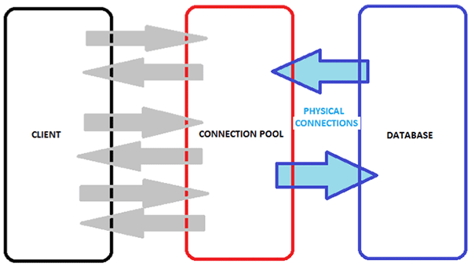
2. The SQL Environment
2.5 Connections
Support remote access to an SQL Server provided that there is a working SQL client.

Slide 14
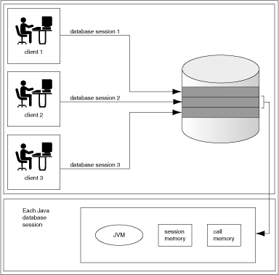
2. The SQL Environment
2.6 Sessions
Operations performed during a connection is called a session.
Each session has its own Catalog and Schema.
Sessions last as long as the connections that created it.

Slide 15
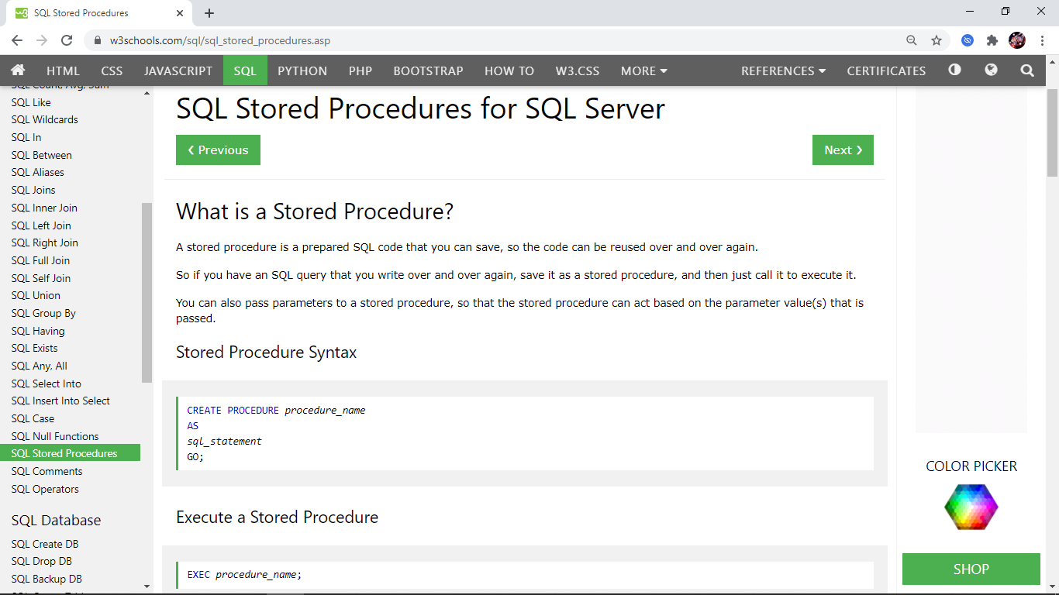
2. The SQL Environment
2.7 Modules
Application programs within SQL
Generic SQL Interface: Normal queries.
Embedded SQL: Require preprocessor.
True Modules: Stored Functions/ Procedures.

Slide 16

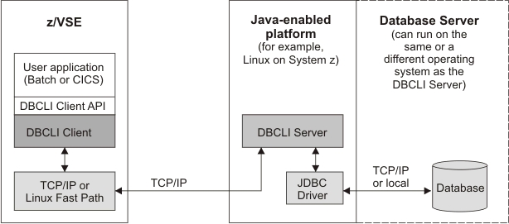
3. SQL/Host-Language Interface
3.1 Call-Level Interface
The host language calls SQL built-in functions from a library.
Example: SQl/CLI, JDBC (Java Database Connectivity).

Slide 17
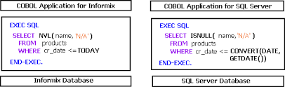
3. SQL/Host-Language Interface
3.2 Embedded SQL
The host language is embedded with SQL statements, such are processed by a preprocessor during compilation.
“Embedded SQL is, by far, the most popular of [the three] traditional binding styles”
(Venkatrao M. & Pizzo M.,1995)

Slide 18
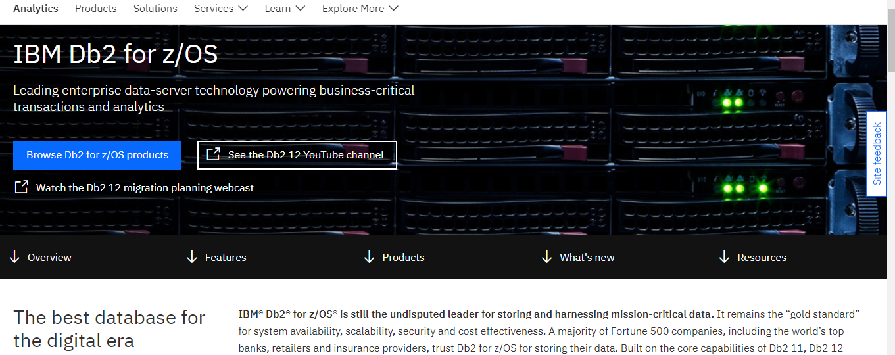
3. SQL/Host-Language Interface
3.2 Embedded SQL
3.2.1 Embedded SQL: Connecting to the host language
Preprocessor to differentiate between the host-language's syntax and SQL's syntax.
Example: Db2 for z/OS, a RDBMS catered for mainframes servers.
Notices:
The keyword “EXEC SQL” must be prepended to the actual SQL statements.
The host language and the SQL Database may access shared data via shared variables, also defined within a SQL query.

Slide 19
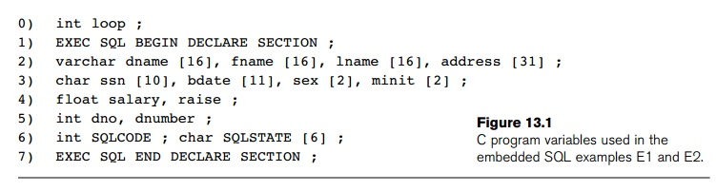
3. SQL/Host-Language Interface
3.2 Embedded SQL
3.2.2 Embedded SQL: The DECLARE section
Shared Variables are declared in this region.
The SQLSTATE is a compulsory array of 5 characters to indicate the batch's state while executing.
Example: ‘00000’ means no error, whereas ‘02000’ means “Tuple not found”.

Slide 20
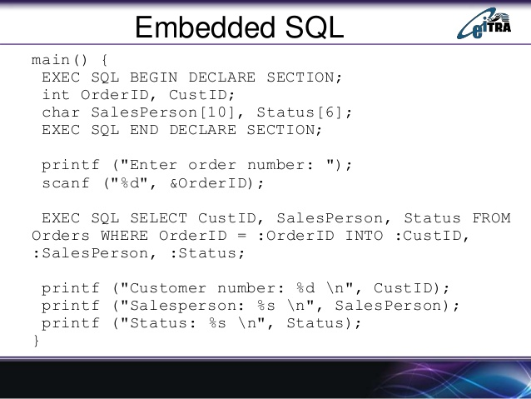
3. SQL/Host-Language Interface
3.2 Embedded SQL
3.2.3 Embedded SQL: Using Shared Variables
Shared Variables must be preceded by a colon “:” when used in a query.

Slide 21
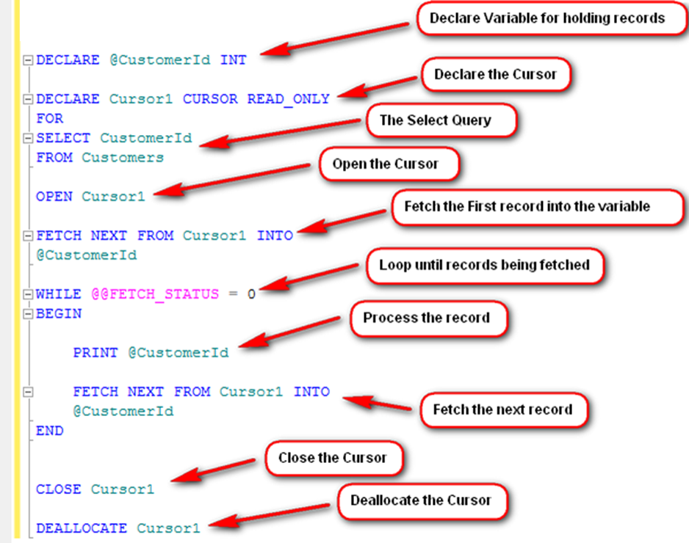
3. SQL/Host-Language Interface
3.2 Embedded SQL
3.2.4 Embedded SQL: Cursors
Cursor is akin to an Iterator. The programmer may update/access/remove data as the cursor proceeds through the table.
“A cursor is a handle to a query execution area, e.g., an area in memory in which a parsed SQL statement and other information for processing the SQL statement is stored.”
(Bastawala M. et al, 2002)

Slide 22
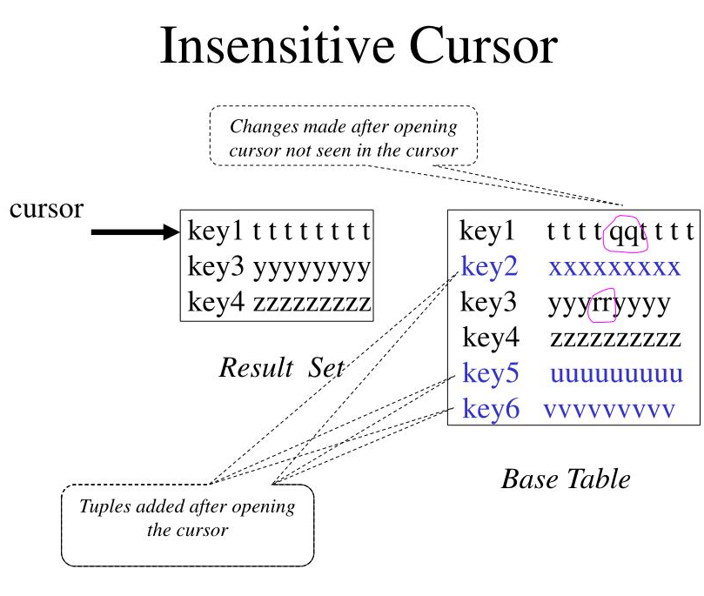
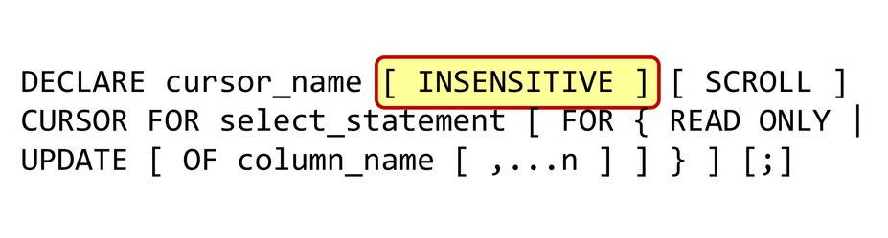
3. SQL/Host-Language Interface
3.2 Embedded SQL
3.2.5 Embedded SQL: Insensitive Cursor
A type of cursor to provide protection against concurrent modification.

Slide 23
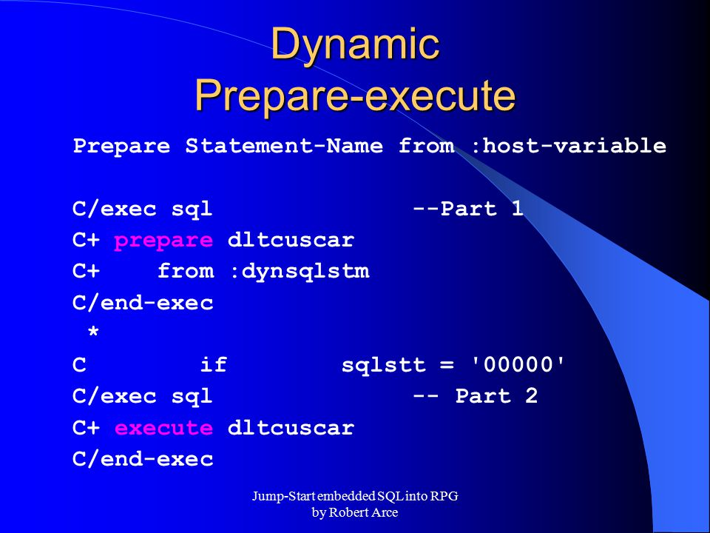
3. SQL/Host-Language Interface
3.2 Embedded SQL
3.2.6 Embedded SQL: Dynamic SQL
SQL commands to be executed at run-time rather than compile time.
Example: Microsoft's SQL Server (C/C++), Oracle SQL (C/C++)
Read from user's input (dynsqlstm) into a SQL's variable (dltcustcar)
Then if no errors happen, execute the variable

Slide 24

4. Stored Procedures
4.1 Creating PSM (Persistent, Stored Modules) Functions and Procedures
4.2 Some Simple Statement Forms in PSM
4.3 Branching Statements
4.4 Queries in PSM
4.5 Loops in PSM
4.6 For-Loops
4.7 Exceptions in PSM
4.8 Using PSM Functions and Procedures

Slide 25
4. Stored Procedures
Introduction
Persistent, Stored Modules (SQL/PSM).
Help to write procedures in a simple, general-purpose language and to store them in the database.
We can use these procedures in SQL queries and other statements to perform computations.
Each commercial DBMS offers its own extension of PSM.

Slide 26
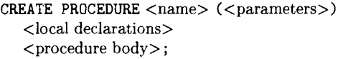
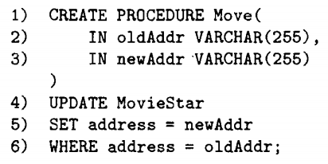
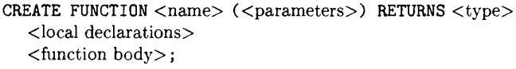
4. Stored Procedures
4.1 Creating PSM (Persistent, Stored Modules) Functions and Procedures
Modules: collections of function and procedure definitions, temporary relation declarations, and other optional declarations.
Note: Function parameters only be in mode IN to avoid side-effects.

Slide 27
4. Stored Procedures
4.2 Some Simple Statement Forms in PSM
The call-statement:
For host-language program:
For generic SQL interface:
The return-statement:
Only appear in a function.
NOT terminate the function ➔ Return-value can be changed before the statement complete.

Slide 28
4. Stored Procedures
4.2 Some Simple Statement Forms in PSM
Declarations of local variable:
Assignment Statement:
Statement groups: List of statement ended by semicolons ; and surrounded by keywords BEGIN and END → treated as a single statement.
Statement labels: Label a statement by prefixing it with a name (the label) and a colon : Example: LABEL:

Slide 29
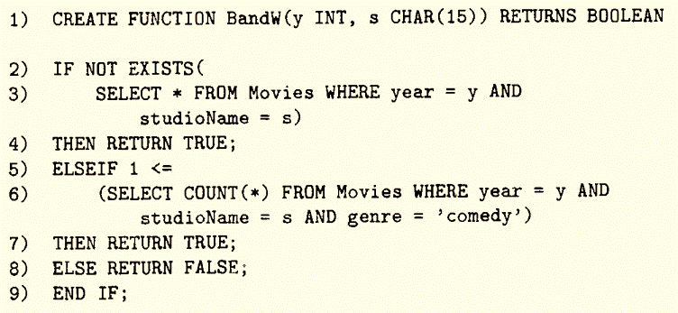
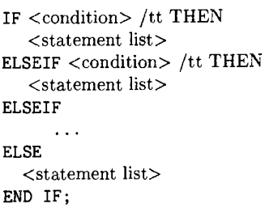
4. Stored Procedures
4.3 Branching Statements
The general form of an if-statement
Example of using if-statement

Slide 30
4. Stored Procedures
4.4 Queries in PSM
Several ways that select-from-where queries are used in PSM:
Subqueries can be used in conditions, or in general, any place a subquery is legal in SQL.
Queries that return a single value can be used as the right sides of assignment statements.
A single-row select statement is a legal statement in PSM.
We can declare and use a cursor for embedded SQL.

Slide 31
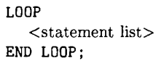
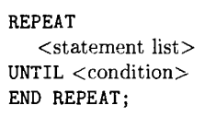
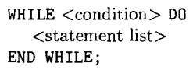
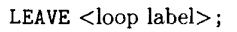
4. Stored Procedures
4.5 Loops in PSM
The basic loop construct in PSM
Other Loop Constructs
Break out of the loop
Example
loop1: LOOP
. . .
LEAVE loop1;
. . .
END LOOP;

Slide 32
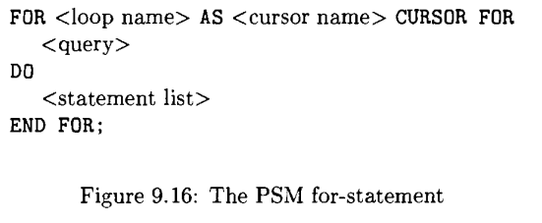
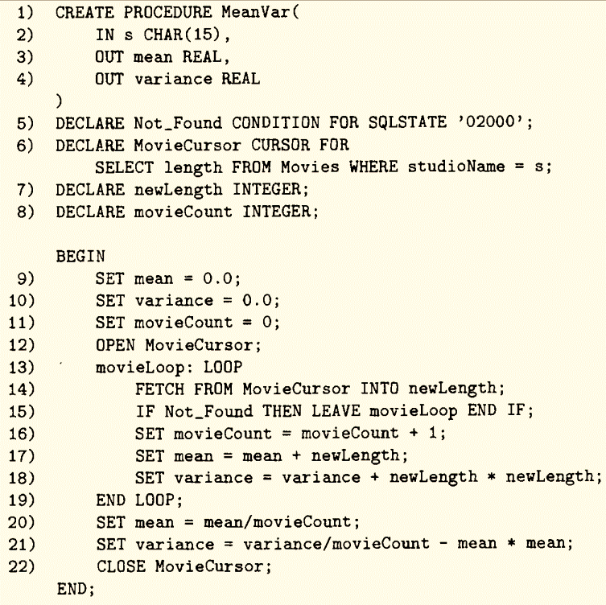
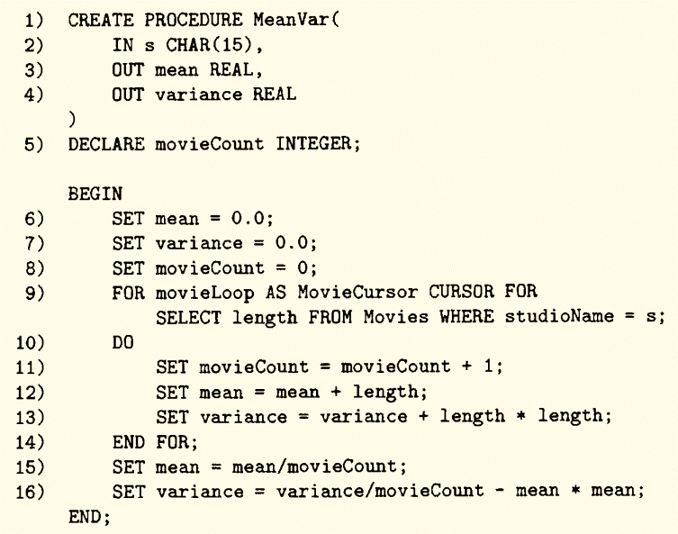
4. Stored Procedures
4.6 For-Loops

Slide 33
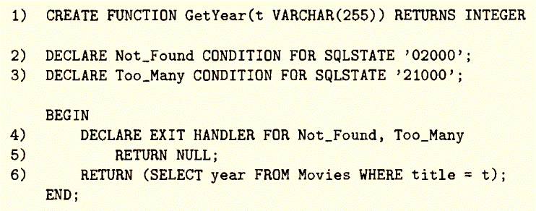
4. Stored Procedures
4.7 Exception in PSM
Form of a handler declaration
CONTINUE
EXIT
UNDO
Where to go next

Slide 34
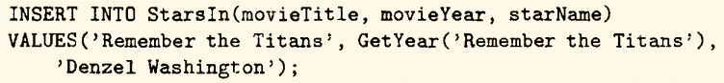
4. Stored Procedures
4.8 Using PSM Function and Procedures
We can call a PSM procedure anywhere SQL statements can appear.
In addition, a PSM function can be used as part of an expression.

Slide 35

5. Using a Call-Level Interface
5.1 Introduction to SQL/CLI
5.2 Processing Statement
5.3 Fetching Data From a Query Result
5.4 Passing Parameters to Queries

Slide 36
5. Using a Call-Level Interface
5.1 Introduction to SQL/CLI
A program writing in C and using CLI while include header file sqlcli.h.
The program is then able to create and deal with 4 kinds of records:
Environments
Connections
Statements
Descriptions (not discussed)
SQLHENV
SQLHDBC
SQLHSTMT
SQLHDESC
HANDLED BY

Slide 37
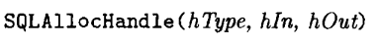
5. Using a Call-Level Interface
5.1 Introduction to SQL/CLI
Handles are created by:
hType: type of handle desired.
hIn: “handle” of higher-level element in which the newly allocated element lives.
hOut: address of the handle that is created by SQLAllocHandle .
SQLAllocHandle also returns a value type of SQLRETURN (integer):
0 if no errors.
Nonzero in the case of errors.

Slide 38
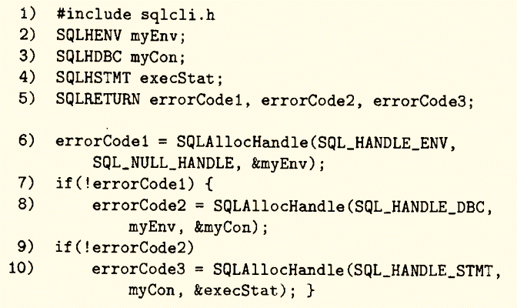
5. Using a Call-Level Interface
5.1 Introduction to SQL/CLI
Example of Declaring and Creating an environment, a connection and a statement

Slide 39
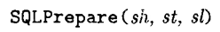
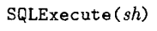
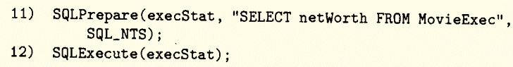
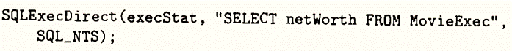
5. Using a Call-Level Interface
5.2 Processing Statements
sh: statement handle.
st: pointer to a SQL statement.
sl: length for character string pointed to by st (SQL_NTS (null-terminated string) to figure it out from the string itself).

Slide 40
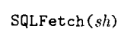
5. Using a Call-Level Interface
5.3 Fetching Data From a Query Result
Where does tuple after fetching appear? ➔ The need of “binding” before fetching.
sh: statement handle involved.
colNo: number of the component (within the tuple).
colType: type for component.
pVar: pointer to variable into which the value is placed.
varSize: length in bytes.
varInfo: pointer to an integer that provide additional information.

Slide 41
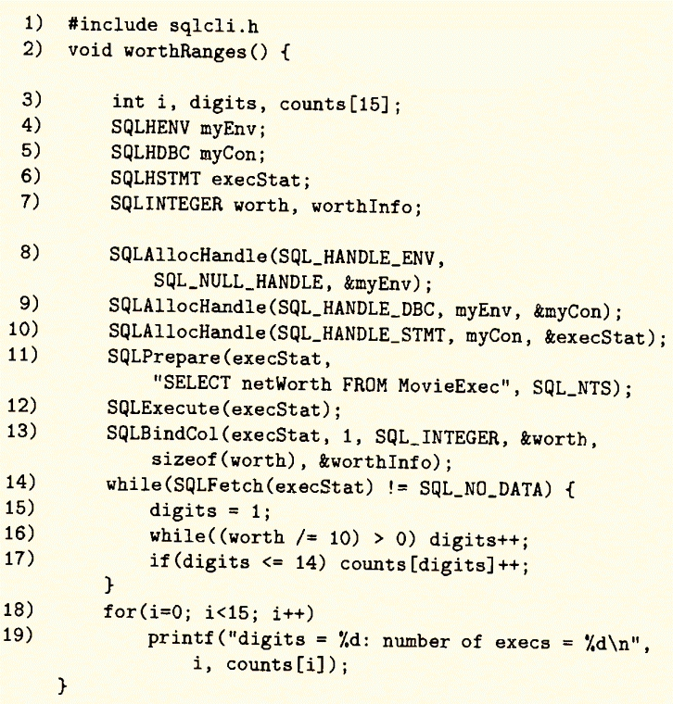
5. Using a Call-Level Interface
5.3 Fetching Data From a Query Result

Slide 42
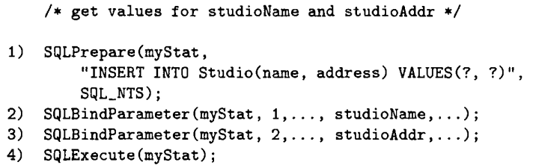
5. Using a Call-Level Interface
5.4 Passing Parameters to Queries
If we put this block into a LOOP, then each time around the loop, a new tuple, with a new name and address for a studio, is inserted into Studio.

Slide 43
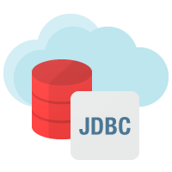
6. JDBC (Java Database Connectivity)
6.1 Introduction to JDBC
6.2 Creating Statements in JDBC
6.3 Cursor Operations in JDBC
6.4 Parameter Passing

Slide 44
6. JDBC (Java Database Connectivity)
6.1 Introduction to JDBC
Remember to: import java.sql.*;
Load a “driver” for database system:
Class.forName(<driver name>); ➔ Class.forName(“com.mysql.jdbc.Driver”);
Establish a connection:
Connection myCon = DriverManager.getConnection(<URL>, <username>, <password>);
jdbc:mysql://<host name>/<database name>

Slide 45
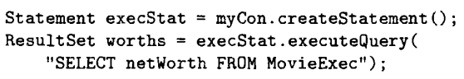
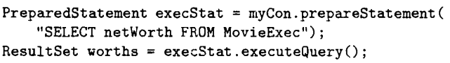
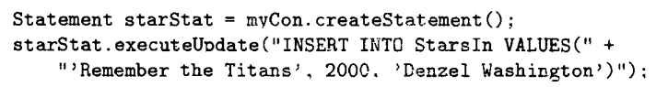
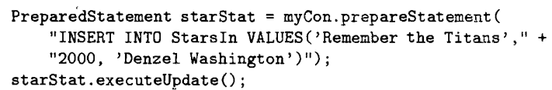
6. JDBC (Java Database Connectivity)
6.2 Creating statements in JDBC
createStatement();
prepareStatement(String query);
executeQuery(String query); or executeQuery();
executeUpdate(String query); or executeUpdate();

Slide 46

6. JDBC (Java Database Connectivity)
6.3 Cursor Operations in JDBC
next(): move to the next tuple.
getString(int i), getInt(int i), getFloat(int i): return the i-th component of the tuple currently indicated by the cursor.

Slide 47

6. JDBC (Java Database Connectivity)
6.4 Parameter Passing
Create a prepared statement → Apply to setString(i,v) or setInt(i,v)
i: the i-th parameter
v: value

Slide 48


6. JDBC (Java Database Connectivity)
6.5 Demonstration – Connect to SQL Server using Java with NetBeans
6.5.1 Installation
https://bit.ly/MSSQLDriver

Slide 49

6. JDBC (Java Database Connectivity)
6.5 Demonstration – Connect to SQL Server using Java with NetBeans
6.5.2 Importing Driver

Slide 50
6. JDBC (Java Database Connectivity)
6.5 Demonstration – Connect to SQL Server using Java with NetBeans
6.5.3 Testing Connection

Slide 51



Slide 52
6. JDBC (Java Database Connectivity)
6.5 Demonstration – Connect to SQL Server using Java with NetBeans
6.5.4 Execute SQL Statements

Slide 53



Slide 54


Slide 55

7. PHP
Introduction
Create HTML web pages
Scripting Language
Hypertext Pre-Processor
PHP

Slide 56
7. PHP
7.1 PHP Basics
Special tags:
<?php
// PHP Commands
?>
Strings:
$x = 2;
$y = ‘FPT’;
$z = “$x $y”; // $z = $x . $y
// $z = “2 FPT”
$t = ‘$x $y’;
Variables:
Untyped and need not to be declared.
$<variable name>

Slide 57
7. PHP
7.2 Arrays
Ordinary arrays (numeric): Arrays with indexes 0, 1, 2…
Arrays that are really mapping (associative arrays): Indexes, or key, are any strings.
array();
Example:
$a = array(1,2,5,6); // $a[0]=1; $a[1]=2; $a[2]=5; $a[3]=6;
$b = array(“id”=>“SE150974”,“name”=>“Tran Phong”,“uni”=>“FPTU”);
/*
$b[‘id’] = “SE150974”; $b[‘name’] = “Tran Phong”;
$b[‘uni’] = “FPTU”;
*/

Slide 58
7. PHP
7.3 The PEAR DB Library
PEAR:
PHP Extension & Application Repository.
Collection of libraries (include DB).
Usage:
include(‘DB.php’);
https://viettuts.vn/php/php-ket-noi-voi-mysql

Slide 59
7. PHP
7.4 Demonstration: Connecting to database (MySQL) using PHP PEAR DB Library
7.4.1 Installation
https://viettuts.vn/php/cai-dat-php
AMP software: WAMPP, XAMPP,..
DB Library: …/xampp/php/pear/
Code Editor: Visual Studio Code, Apache NetBeans IDE, Notepad++…
Internet Browser: Google Chrome, Microsoft Edge…
Documentation: https://pear.php.net/manual/en/package.database.mdb2.intro-fetch.php
https://pear.php.net/package/DB/download/1.9.2

Slide 60


7. PHP
7.4 Demonstration: Connecting to database (MySQL) using PHP PEAR DB Library
7.4.2 Database
Database: phpdemo
Table: students

Slide 61

7. PHP
7.4 Demonstration: Connecting to database (MySQL) using PHP PEAR DB Library
7.4.3 Result

Slide 62

7. PHP
7.4 Demonstration: Connecting to database (MySQL) using PHP PEAR DB Library
7.4.3 Result

Slide 63
7. PHP
7.4 Demonstration: Connecting to database (MySQL) using PHP PEAR DB Library
7.4.4 Code – index.php
https://github.com/ntrphongse/PHPDemo

Slide 64

mssql | Microsoft SQL Server
mysql | MySQL
mysqli | MySQL Improved
oci8 | Oracle 7/8/8i
odbc | ODBC (Open Database Connectivity)
pgsql | PostgreSQL
sqlite | SQLite
$db = DB::connect(“<vendor>://<username>:
<password>@<host server>/<database name>”);
vendor | Connection type
username | Username to login the database
password | Password to login the database
host server | The address of your server
database name | The database name to use

Slide 65
$result = $db->query(“<your SQL statements>”);
$result->numRows() | Return number of rows that were returned from a SELECT statement
$result->numCols() | Return number of columns (attributes) that were returned from a SELECT statement
$result->affectedRows() | Return number of rows that were altered by an UPDATE, INSERT or DELETE statement

Slide 66

$result->fetchRow([FetchMode]);
FetchMode
DB_FETCHMODE_ORDERED (default) | Return an ordinary array that corresponds to the fetched row.
DB_FETCHMODE_ASSOC | Return an associative array that corresponds to the fetched row.
$result->free();
$db->disconnect();
Notes:
fetchRow(): Read an entire row. The result pointer gets moved to the next row each time the method is called. NULL is returned when the end of the result set is reached.
Fetch: Lấy

Slide 68
7. PHP
7.4 Demonstration: Connecting to database (MySQL) using PHP PEAR DB Library
7.4.5 Code – create.php

Slide 69


Slide 70

$prep = $db->prepare(“
<Prepared commands>”);
$db->execute($prep, $data);
Notes:
SQLPrepare

Slide 72

References
John M. Gallaugher & Suresh C. Ramanathan (1996). Choosing a Client/Server Architecture, Information Systems Management, 13:2, 7-13, DOI: 10.1080/10580539608906981
Caballé, Santi & Xhafa, Fatos & Raya, Jordi & Barolli, Leonard & Uchida, Kazunori. (2014). Building a Software Service for Mobile Devices to Enhance Awareness in Web Collaboration. Proceedings - 2014 International Conference on Intelligent Networking and Collaborative Systems, IEEE INCoS 2014. 10.1109/INCoS.2014.11.
Goldberg, R. N., & Jirak, G. A. (1993). U.S. Patent No. 5,201,046. Washington, DC: U.S. Patent and Trademark Office.
https://medium.com/@k.wahome/database-connections-less-is-more-86c406b6fad
Venkatrao M. & Pizzo M. (1995). SQL/CLI—a new binding style for SQL. SIGMOD Rec. 24, 4 (Dec. 1995), 72–77. DOI:https://doi.org/10.1145/219713.219763
Bastawala M. et al. (2002). Method and system for scrollable cursors.
Cursors Organized by Farrokh Alemi, Ph.D. Narrated by Yara Alemi
Www.PrismaTech.net Jump-Start Embedded SQL into RPG Presented by: Robert Arce.
http://www.hackingwithphp.com/
https://www.php.net/

